Slide 1
Check Out our PowerPoint Graphics Library
Personal Development Learning
Hello, my name is Jonathan Manton.
I am a Senior Management Information Analyst and the below slides detail the majority of the learning I have completed through the website Udemy in order to develop myself both personally and professionally.
I have a real passion for learning and development and am very proud of the time and effort it took to complete all these courses. Not only was it fun to gain new knowledge it has also allowed me to utilise these new skills to the benefit of my team and the business over the last four years.

Slide 2

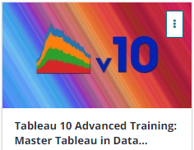

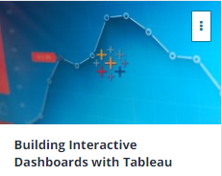
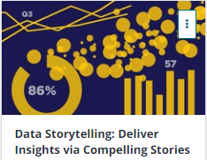
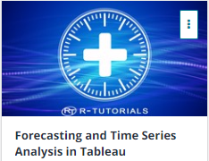

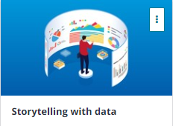


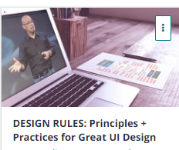
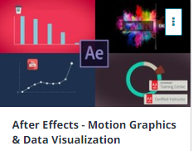
Check Out our PowerPoint Graphics Library
Data Visualisation

Slide 3

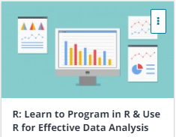
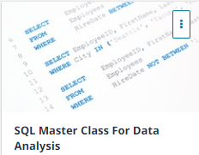
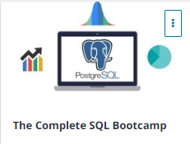



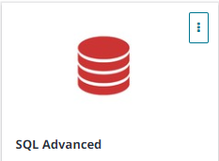
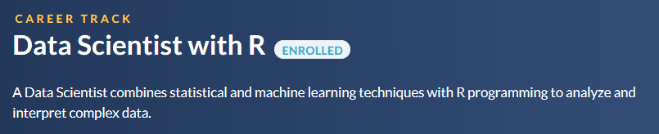
Check Out our PowerPoint Graphics Library
Data Science (R and Python)

Slide 4

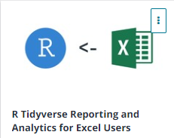

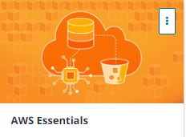

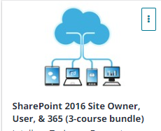


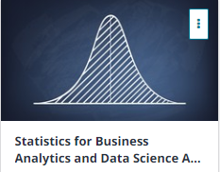

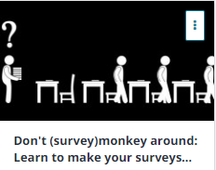
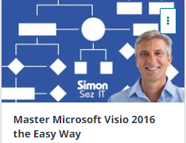

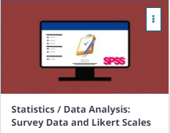
Check Out our PowerPoint Graphics Library
Miscellaneous

Slide 5



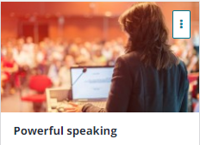








Check Out our PowerPoint Graphics Library
Soft Skills

Slide 6
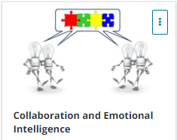
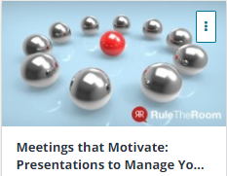


Check Out our PowerPoint Graphics Library
Soft Skills

